Slide 1
BITS ZG553: Real Time Systems L12 – Software Design & Development for Real Time Systems
K G Krishna
WILP Division, BITS-Pilani, Hyderabad

Slide 2


Text Book / References
Reference (R1)
Text Book (T1)
Note: As the above two books focus on theoretical treatment of the subject, Students are strongly advised to refer to web sources / MOOCs videos / library within their own organizations for more practical understanding of the topics.

Slide 3

Excellent MOOCs Videos
(Coursera, edX,…)

Slide 4
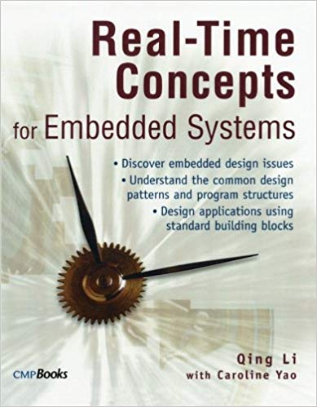
RTS Primer – For Light Reading

Slide 5
L-12: Software Design & Development for RTS
[Quality, Performance Considerations]
[Ref: Notes/PPT]
Note: Students are requested to NOT to rely on PPTs/Recorded sessions as their only source of knowledge, explore sources within your own organization or web for any specific topic; attend classes regularly and involve in discussions;
PLEASE DO NOT PRINT PPTs, Save the Environment!
Source PPT Courtesy: Some of the contents of this PPT is sourced from Presentatoons of Prof K R Anupa / Prof B Mishra, BITS-Pilani WILP Division

Slide 6
Qualities of Real-Time Software
Reliability
Correctness
Performance
Usability
Interoperability
Maintainability
Portability
Verifiability

Slide 7
Reliability
A measure of whether a user can depend on the software.
The system “stands the test of time.”
There is an absence of known catastrophic errors; that is, errors that render
the system useless.
The system recovers “gracefully” from errors.
The software is robust.
For real-time systems, other informal characterizations of reliability might include
Downtime is below a certain threshold.
The accuracy of the system is within a certain tolerance.
Real-time performance requirements are met consistently.
Traditionally, MTFF (Mean Time To First Failure) and MTBF (Mean Time Between Failures) are used as a measure of Software Reliability.

Slide 8
Software Reliability – Statistical Perspective
Let S = The software system
T = Time instance of failure
Then Reliability of S at any time instance t, is defined by
r(t) = P(T > t)
r(t) = 1 is the ideal case. Practically, r(t) is less than 1.
Example:
In the monitoring system of a nuclear power plant, the failure probability is no more than 10⁻⁹ per hour.
So, r(t) = (1 - 10⁻⁹)^{t}, t is in hours.
So, as t->∞, r(t) -> 0.

Slide 9
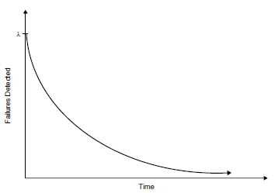
Software Reliability – Statistical Perspective
Another way is to characterize software reliability is in terms of a failure function, which is usually an exponential function,
f(t) = λ/e^{λt}, t ≥ 0
‘λ’ is a system dependent parameter, determined empirically.
Source: P. A. Laplante, Real-Time Systems Design and Analysis, Wiley, 3rd edition

Slide 10
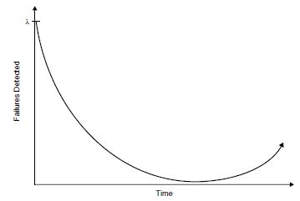
Software Reliability – Statistical Perspective
But the failure function tends to become a bathtub curve i.e. failures reduces initially at an exponential rate, but increases towards the end.
Source: P. A. Laplante, Real-Time Systems Design and Analysis, Wiley, 3rd edition

Slide 11
Software Reliability – Statistical Perspective
Reasons for Bathtub curve for failures:
Hardware can wear and tear. So after some point of time, the number of failures increases.
But software can’t wear and tear. Then why bathtub curve for the software ?
During patch releases, making quick correction without designing them properly.
During patch releases, ignoring the effect of the new bug fix on other modules (thereby fixing one issue and introducing more new issues)
Inadequate testing of the software during patch releases.
Wear and tear of underlying hardware.

Slide 12
Correctness
Closely related to reliability and the terms are often used interchangeably.
The main difference is that minor deviation from the requirements is strictly considered a failure and hence means the software is incorrect. However, a system may still be deemed reliable if only minor deviations from the requirements are experienced.
Correctness is measured in terms of number of failures detected over time.

Slide 13
Performance
A measure of some required behavior.
For example, an imaging system might be required to display a filtered image at a rate of 30 frames per second.
A photo reproduction system might be required to digitize, clean and output color copies at a rate of 1 every two seconds.
Can be measured via mathematical or algorithmic complexity, direct timing, or simulation.

Slide 14
Usability
Often referred to as ease of use, or user friendliness.
Usability is difficult to quantify (but we can easily determine its absence).
However, informal feedback can be used, as well as user feedback from surveys and problem reports can be used in most cases.

Slide 15
Interoperability
Refers to the ability of the software system to coexist and cooperate with other systems.
In imaging systems the software must be able to communicate with various devices using standard bus structures and protocols.
Open systems and standards foster interoperability.
Interoperability can be measured in terms of compliance with open system standards.

Slide 16
Maintainability
A software system in which changes are relatively easy to make, has a high level of maintainability.
Two contributing properties – evolvability and reparability.
Evolvability is a measure of how easily the system can be changed to accommodate new features or modification of existing features.
Software is repairable if it allows for the fixing of defects.

Slide 17
Portability
Software is portable if it can easily run in different environments.
Portability is achieved through a deliberate design strategy in which hardware dependent code is confined to the fewest code units as possible.
For making the upper-layer software independent of the underlying hardware architecture, usually a Hardware Abstraction Layer (HAL) is implemented.
Can be achieved using either object-oriented or procedural programming languages and through object-oriented or structured approaches.
Also using standardized APIs (such as POSIX calls), improves the portability
Person months required to perform the port are the standard measure of this property

Slide 18
Verifiability
A software system is verifiable if its properties can be verified easily.
Can be achieved through the insertion of code that is intended to monitor various qualities such as performance or correctness.
Modular design, rigorous software engineering practices and the effective use of an appropriate programming language can also contribute to verifiability.

Slide 19
Software Design Life Cycle (SDLC) Models
Waterfall Model
V Model
Spiral Model
Agile Methodologies

Slide 20
Waterfall Model
Requirements
Architecture
Design
Development
Testing
Maintenance

Slide 21
V Model
As per the model, the development and QA teams should interact all phases and work in parallel.
During ‘Requirement’ phase, ‘System Validation’ team should be involved in understanding the requirements and creating the top level test plan.
Similarly during ‘Design’ phase ‘Integration and Testing’ phase should also start creating the testcases.
Quality Assurance Actions
System Validation
Requirements
Integration and Testing
Design
Programming and
Module Testing
Time

Slide 22
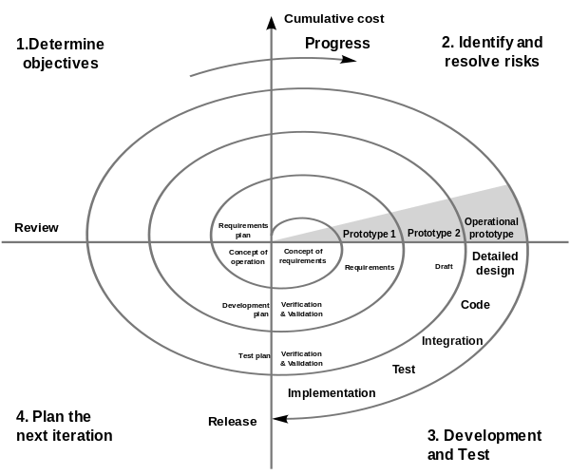
Spiral Model
Source: https://en.wikipedia.org/wiki/Spiral_model#/media/File:Spiral_model_(Boehm,_1988).svg

Slide 23
Agile Scrum
Product Backlog (Overall Requirements)
Sprint1 Backlog
Sprint2 Backlog
…
Architecture
Design
Architecture
Design
Testing
Implementation
Testing
Implementation
Review
Review
SPRINT 1
SPRINT 2
…

Slide 24
Software Design Approaches

Slide 25
Software Design Approaches
Procedural Design Approach
Parnas Partitioning
Structured Design
Object Oriented Design Approach
UML (Unified Modeling Language) based Design

Slide 26
Parnas Partitioning
Cohesion indicates the dependencies between modules. i.e.
High cohesion between two modules indicates tight dependencies between them.
Low cohesion between two modules indicates lesser dependencies between them.
Parnas Partitioning involve the software into multiple modules, which have low external coupling and high internal cohesion.
If any change has to be made to a module, then there is high probability that the changes are localized to the specific module.
Individual modules then hide their internal implementations to other modules and expose only required interfaces meant for communication between the modules. It is the principle of ‘information hiding’.

Slide 27
Structured Design (SD)
Companion methodology to Structured Analysis (SA) – Both are combine known as SA/SD (SD follows SA)
Transition from SA to SD is manual.
One of the very important diagram is Data Flow Diagram (DFD)
DFD evolves from the Context Diagram (CD)
DFDs are used to partition the system.
Level 0 DFD is the first DFD, which illustrates the highest level of system abstraction.
Then these DFDs are subdivided into lower and lower levels until they are ready for detailed design.
Modules are represented by circles (and labeled by verb phrases)
The data flow is indicated by solid lines with arrowhead indicating the direction of the flow (and labeled by noun phrases)
Control flow is indicated by dashed lines with arrowhead indicating the direction of the flow

Slide 28
Data Flow Diagrams (DFD)
One of the very important diagram is Data Flow Diagram (DFD)
DFD evolves from the Context Diagram (CD)
DFDs indicate flow of the data between different modules in the system.
Level 0 DFD is the first DFD, which illustrates the highest level of system abstraction.
Then these DFDs are subdivided into lower and lower levels until they are ready for detailed design.
Modules are represented by circles (and labeled by verb phrases)
The data flow is indicated by solid lines with arrowhead indicating the direction of the flow (and labeled by noun phrases)
Control flow is indicated by dashed lines with arrowhead indicating the direction of the flow

Slide 29
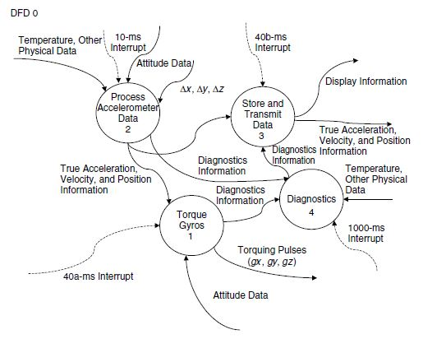
DFD Example
Level 0 DFD for a intertial measurement system. Dashed lines indicate control flow.
Source: P. A. Laplante, Real-Time Systems Design and Analysis, Wiley, 3rd edition

Slide 30
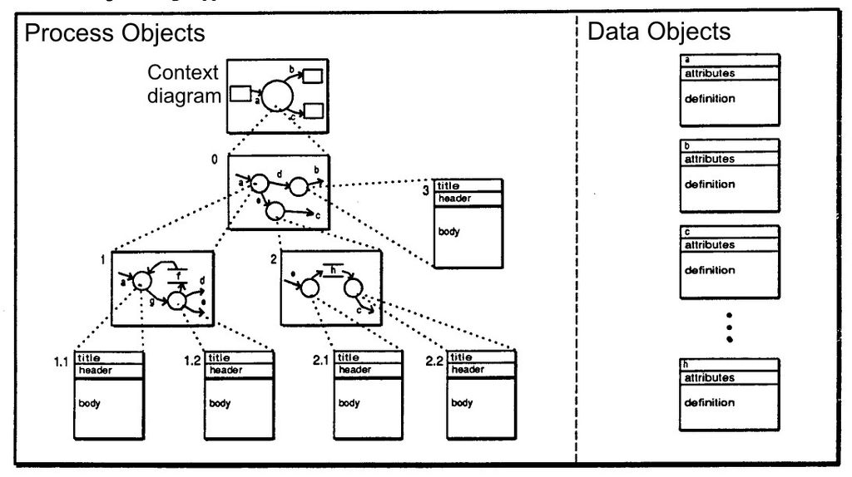
Evolution of DFD from CD to Lower Level Design Specification
Source: Wikipedia (https://en.wikipedia.org/wiki/Structured_analysis#/media/File:Analysis_Model_Objects.jpg)

Slide 31
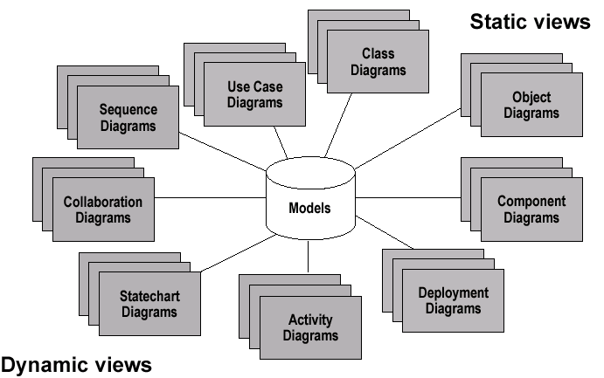
Unified Modeling Language (UML)
It is the de facto standard for Object Oriented Design.
Graphical language based on the concept that any system can be composed of communities of interacting entities.

Slide 32
Class Diagram
Gives an overview of a system by showing its classes and the relationships among them.
Class diagrams are static
they display what interacts but not what happens when they do interact
Also shows attributes and operations of each class
Good way to describe the overall architecture of system components

Slide 33
Class Representation
Class name
A class is a rectangle divided into three parts
Class name
Class attributes (i.e. data members, variables)
Class operations (i.e. methods)
Modifiers
Private: -
Public: +
Protected: #
Static: Underlined (i.e. shared among all members of the class)
Abstract class: Name in italics
Attributes (Properties)
Operations (Methods)
Example:
Employee
-Name: string
+ID: int
#Salary: int
+GetName(): string
+SetName(string sName)
-CalcSalary(int ID)

Slide 34
Relationship Between Classes
Association
A relationship between instances of two classes, where one class must know about the other to do its work, e.g. client communicates to server
Each classes have their own life-cycle (i.e. their creation and destruction are not dependent on each other.
indicated by a straight line or arrow
Aggregation
An association where one class belongs to a collection
But the child object doesn’t die if parent object dies
Indicated by an empty diamond on the side of the collection
Composition
Strong form of Aggregation
Lifetime control; components cannot exist without the aggregate
When the parent object dies, the child object also dies
Indicated by a solid diamond on the side of the collection
Inheritance
An inheritance link indicating one class a superclass relationship, e.g. human is a mammal
Indicated by triangle pointing to superclass

Slide 35
Association
Binary Association (Both Classes Know About Each Other)
Indicated by a straight line.
Unary Association (Only One Class Know About the Other, Other Doesn’t)
Indicated by an arrow starting from the class that has knowledge about the other class and pointing to the class that doesn’t have knowledge about the previous class.
public Class HRManager {
SwipeCard swipeCard;
…….
}
HR Manager
Finance Manager
-Name: string
+ID: int
…….
-Name: string
+ID: int
………
+GetName(): string
+SetName(string sName)
…………
+GetName(): string
+SetName(string sName)
…………
HR Manager
Swipe Card
-Name: string
+ID: int
…….
+ID: int
………
+GetName(): string
+SetName(string sName)
…………
+GetId(): integer
…………

Slide 36
Association: Multiplicity
Multiplicity
Symbol Meaning
1 One and only one
0..1 Zero or one
M..N From M to N
* Or 0..* From zero to any positive integer
1..* From one to any positive integer
HR Manager
Finance Manager
1
1
-Name: string
+ID: int
…….
-Name: string
+ID: int
………
+GetName(): string
+SetName(string sName)
…………
+GetName(): string
+SetName(string sName)
…………
HR Manager
R & D Manager
1
*
-Name: string
+ID: int
…….
-Name: string
+ID: int
………
+GetName(): string
+SetName(string sName)
…………
+GetName(): string
+SetName(string sName)
…………

Slide 37
Aggregation & Composition
Aggregation
A bigger entity containing smaller entities or components
A component can be part of an aggregation
Example: Engineering Team can have architects, who are shared between multiple team.
Composition
A special case of aggregation, where the component can’t exist without the aggregated entity
public Class EngineeringTeam {
Engineer engineer[10];
…….
}
Engineering Team
Architect
-Name: string
+ID: int
…….
1
2
-Name: string
+ID: int
………
+GetName(): string
+SetName(string sName)
…………
+GetName(): string
+SetName(string sName)
…………
Engineering Team
Engineer
-Name: string
+ID: int
…….
1
10
-Name: string
+ID: int
………
+GetName(): string
+SetName(string sName)
…………
+GetName(): string
+SetName(string sName)
…………

Slide 38
Inheritance
Inheritance
The child class inherits the properties and operations of the base class
Adds its own specific functionalities as well
Employee
-Name: string
+ID: int
………
+GetName(): string
+SetName(string sName)
…………
Engineer
-Name: string
+ID: int
………
+GetName(): string
+SetName(string sName)
…………

Slide 39
Metrics in Software Engineering
Lines of Source Code
Cyclomatic Complexity
Halstead’s Metrics
Function Points
Feature Points

Slide 40
Lines of Source Code
Measured in thousands of lines of code (KLOC).
It doesn’t include comments.
But it doesn’t indicate the complexity of the code (we can’t say that a program having 1000 lines of code is more complex and can have more errors then a program having 100 lines of code.
Another major disadvantage is that KLOC can be calculated after the code is written.
Another related metrics is ‘Delta KLOC’, indicating the amount of code added incrementally.
As the project matures, ‘Delta KLOC’ should reduce.

Slide 41
Cyclomatic Complexity
Introduced by McCabe
The concept fits well with Procedural Programming, but not quite well with Object-Oriented Programming
It is based on determining the number of linearly independent paths in a program.
Consider a graph, where the nodes represent the program segment and the edges represent independent paths.
Let the number of nodes = n and number of edges = e.
Then the cyclomatic complexity,
C = e –n + 2
Commercial tools are available to calculate cyclomatic complexity.

Slide 42
Cyclomatic Complexity - Example
For the graph shown, n = 6, e =9.
So, cyclomatic complexity C = e – n + 2 = 9 – 6 + 2 =5
a
b
c
d
e
f

Slide 43
Halstead’s Metrics
One drawback of Cyclomatic complexity is that it measures complexity as a function of control flow, but complexity can exist the way programming language is used.
Halstead’s metrics measures how intensively the programming language is used.
Let
n₁ = The number of distinct syntactic begin-end pairs called ‘operators’ - operator carries out an action
n₂ = The number of distinct statements called ‘operands’ - operand participates in such an action
N₁ = Total number of occurrences of n₁ in the program
N₂ = Total number of occurrences of n₂ in the program

Slide 44
Halstead’s Metrics
Program Vocabulary, n = n₁ + n₂
Program Length, N = N₁ + N₂
Program Volume, V= N log₂ n
Calculated program length, N* = n₁ log₂ n₁ + n₂ log₂ n₂
Difficulty Level, D = (n₁ / 2)X(N₂ / n₂)
Programming Effort, E = D X V
The difficulty measure D is related to the difficulty of the program to write or understand
The effort measure translates into actual coding time using the following relation.
Time required to program, T = E / 18 seconds
Number of delivered bugs, B = V / 3000 (it was E^{2/3}/3000 earlier)

Slide 45
Halstead’s Metrics - Example
(Source: https://en.wikipedia.org/wiki/Halstead_complexity_measures)
Let us consider the following C program.
void main()
{
int a, b, c, avg;
scanf("%d %d %d", &a, &b, &c);
avg = (a + b + c) / 3;
printf("avg = %d", avg);
}
Here,
The unique operators are: main, (), {}, int, scanf, &, =, +, /, printf
The unique operands are: a, b, c, avg, "%d %d %d", 3, "avg = %d“
So,
n₁ = 10, n₂ = 7,
N₁ = 16, N₂ = 15

Slide 46
Halstead’s Metrics - Example
(Source: https://en.wikipedia.org/wiki/Halstead_complexity_measures)
Program Vocabulary, n = n₁ + n₂ = 10 + 7 = 17
Program Length, N = N₁ + N₂ = 16 + 15 = 31
Program Volume, V= N log₂ n = 31 log₂ 17 = 31 X 4.087 = 126.697
Calculated program length,
N* = n₁ log₂ n₁ + n₂ log₂ n₂ = 10 log₂ 10 + 7 log₂ 7 = 10X3.32 + 7X2.81 = 33.2 + 19.67 = 52.87
Difficulty Level,
D = (n₁ / 2)X(N₂ / n₂) = (10 / 2) X (15 / 7) = 5 X 2.142 = 10.714
Programming effort,
E = D X V = 10.714 X 126.697 = 1357.468
Time required to program,
T = E / 18 seconds = 1357.468 / 18 seconds = 75.41 seconds
Number of delivered bugs,
B = V / 3000 = 126.697 / 3000 = 0.04223
(With the earlier formula, B = E^{2/3}/3000 = (1357.468)^{2/3} / 3000 = 122.5991 / 3000 = 0.04)

Slide 47
Function Points
The philosophy here is the measure the functionality of the software via the number of interfaces between modules and subsystems in programs or entire systems.
Generally used for business information systems, but is also used for large scale real-time systems like multimedia and communication systems.
5 software characteristics for each module or subsystem:
A1 = Number of inputs to the application (I )
A2 = Number of outputs (O)
A3 = Number of user inquiries (Q)
A4 = Number of files used (F)
A5 = Number of external interfaces (X)

Slide 48
Function Points
Then the function point,
Where, W_{i} = Weighting factors
A_{i} = Item counts
F_{j} = Complexity Adjustment Factors
The weighting factors and complexity adjustment factors are adjusted experimentally.
Following is the way to calculate the complexity adjustment factors.

Slide 49
Function Points – Complexity Adjustment Factors
A set of 14 questions that are answered on a scale from 0 to 5 where:
0 no influence
1 incidental
2 moderate
3 average
4 significant
5 essential

Slide 50
Function Points – Complexity Adjustment Factors
The 14 Questions to be asked for a real-time system:
Does the system require reliable backup and recovery?
Are data communications required?
Are there distributed processing functions?
Is performance critical?
Will the system run in an existing, heavily utilized operational environment?
Does the system require on-line data entry?
Does the on-line data entry require the input transactions to be built over multiple screens or operations?
Are the master files updated on-line?
Are the inputs, outputs, files, or inquiries complex?
Is the internal processing complex?
Is the code designed to be reusable?
Are the conversion and installation included in the design?
Is the system designed for multiple installations in different organizations?
Is the application designed to facilitate change and ease of use by the user?

Slide 51
Function Points – Example
For an embedded system, the answers to the 14 questions came like the following.
A : 4 B : 5 C : 5 D : 5 E : 5 F : 4 G : 4
H : 5 I : 4 J : 4 K : 4 L : 5 M : 5 N : 5
Then ∑F_{j} = 4 X 6 + 5 X 8 = 64
Let the item numbers and corresponding weights are as follows
A1 = I = 5 W1 = 4
A2 = U = 7 W2 = 4
A3 = Q = 8 W3 = 5
A4 = F = 5 W4 = 10
A5 = X = 5 W5 = 7
Then the function point,

Slide 52
Lines of code per function points
Programming Language | Lines of code / Function point
Assembly | 320
C | 128
C++ | 64
Object oriented languages take lesser code to implement a feature.
Source: P. A. Laplante & S. J. Ovaska, Real-Time Systems Design and Analysis: Tools for the Practitioner, Wiley, 4th edition

Slide 53
Feature Points
It is an extension of Function Points.
In order to make it more suitable for real-time systems like mobile communication systems, process control systems etc, one more item is included – that is ‘Algorithm’
6 software characteristics for each module or subsystem:
A1 = Number of inputs to the application (I )
A2 = Number of outputs (O)
A3 = Number of user inquiries (Q)
A4 = Number of files used (F)
A5 = Number of external interfaces (X)
A6 = Item count for algorithms (A)

Slide 54
Feature Points- Example
In the previous example, let us have
A6 = 10, W6 = 7.
Then feature point,
So, if the language used is C,
then approx lines of code for this module
= 128 X 294 = 37.632 KLOC

Slide 55
Thank You.
Any Questions?

